Slide 1


Rational Design of Multitarget Ligands
Polypharmocology: Challenges and Opportunities in Drug Discovery
Andrew Anighoro, Jürgen Bajorath and Giulio Rastelli
J. Med. Chem. 2014, 57, 7874-7887
Presented by
Sakthi Lalitha Sri Swaminathan
M.Sc. Life Science Informatics
Matriculation Nr. 2917061

Slide 2
Outline
Introduction
Activity Landscapes
Main strategies
Rational Pharmacological Approaches
Conclusion

Slide 3
Introduction
Polypharmacology - improves the ability to rationally exploit polypharmacological effects
Rational Design - process of finding new drugs based on the knowledge of a biological target.
Structure-Activity Relationship – important for multitarget activity
Challenge – targets are distantly related or unrelated
Notes:
Polypharmacology is the design or use of pharmaceutical agents that act on multiple targets or disease pathways
Understanding polypharmacology is important
polypharmacology may be a necessary trait for the efficacy of many drugs
SAR – relationship between a chemical and its biological activity
enables the determination of the chemical groups responsible for evoking a target biological effect
When they belong to different protein families
Critical point for the development of multitargeted drugs

Slide 4
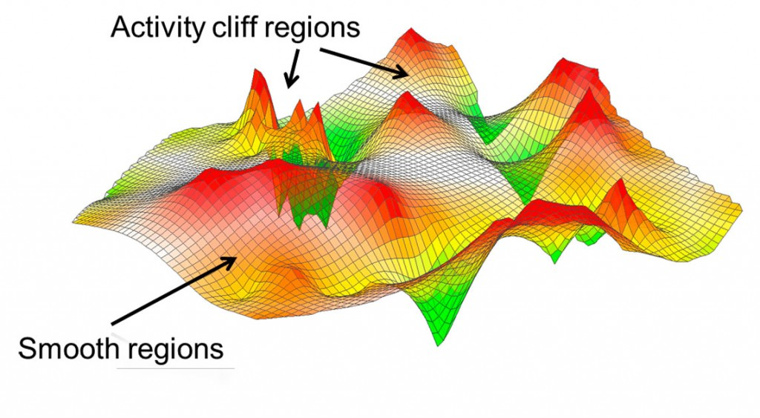
Activity Landscapes
Theoretical hyperspaces in chemical space
Represents relation between structural similarity and biological activity
Modeling multitarget activity landscapes – provides insight into SAR
Source: http://www.int.laborundmore.com/thumb/dfce26c5/Bajorath_02_lm0213_INT.jpg
Date of accession : 20th November,2016
Notes:
Activity cliff and smooth regions are indicated. In activity cliff regions, small chemical modifications of compounds (i.e., very short ‘moves’ in chemical space) have a profound effect on biological activity. By contrast, in smooth regions, structurally diverse compounds have similar activity.
Modelling of multitarget activity landscapes provide useful insights into SAR of ligands active on proteins spanning different families
Exploration of multitarget SARs is the first step in the rationalization of multitarget profiles

Slide 5
Main Strategies
Iterative chemical synthesis, x-ray crystallography and biochemical profiling
Structural features in protein/ligand complexes
First successful rational design – multitarget ligands within human kinome
Different approaches were followed to design ligands with desirable polypharmacological profiles
Notes:
This article describes the main strategies and applications that are proposed to rationalize the design of multitarget ligands.
These methods discovered compounds with dual-target activity
Features were examined to rationalize selectivity toward targets
Kinome – set of protein kinases within the organism genome

Slide 6
Approaches
Automated approach
Bayesian models
Example : Donepazil – therapy of AD
Computational approach
Fragment-based method
allows optimization of hit compounds
Ligand-based approach
Similarity Ensemble approach (SEA)
Tanimoto coefficient and BLAST algorithm
Notes:
Automated approach – design of small libraries of analogues of an initial compound through automated machine learning of medicinal chemistry design strategies
Bayesian models – they prioritize the generated compounds according to activity toward different targets or ADME(absorption, distribution, metabolism, and excretion) properties
Donepazil – acetylcholine esterase inhibitor
Fragment based method – generation of libraries enriched with molecular structures focused on targets improve the likelihood of identifying multitarget compounds
SEA – identify protein sharing related ligand sets and also the off-target activities of the drugs ,new active molecules, chemoinformatics analyses
SEA- quantitatively evaluates chemical similarity of ligand pairs by measuring Tanimoto coefficient and BLAST algorithm to normalize the similarity scores

Slide 7
Approaches(contd.)
Self-organizing map based prediction of drug equivalence relationships (SPiDER)
profile the targets of de novo designed molecules
based on self-organizing maps (SOM), consensus scoring, statistical analysis
Molecular docking or Homology models of target proteins
Notes:
SPiDer- merges the concepts of self-organizing maps, consensus scoring, and statistical analysis to identify targets for both known drugs and computer-generated molecular scaffolds.
SOMs – artificial neural network representing competitive learning based neural networks for molecular feature extraction.
SPiDER uses SOMs to extract a relevant subset of known drugs that are meaningfully related to the query compound according to chemical similarity (pharmacophore features, physical/chemical properties).
MD or HM – provide a valuable strategy for screening libraries of potential ligands active against multiple receptors

Slide 8
Rational polypharmacology approaches
Chemical Genetics
Medicinal Chemistry
Multitarget Drug Design
Computational Methods
SAR Analysis
Notes:
Integration of complementary field of studies
Chemical genetics – Identification of targets and antitargets
Medicinal chemistry – structural modifications to optimize multitarget activities
SAR analysis – chemical space exploration to rationalize multitarget activity
Computational methods – building target focused compound libraries, prioritization through machine learning and biological activity prediction by virtual screening methods

Slide 9
Conclusion
Rational design of multitarget ligands is a challenge
Solution : integrated approaches
- medicinal chemistry, genetics, chemical biology and computational chemistry
Major computational approaches
- data mining and ligand based analyses
- virtual screening
Rational polypharmacology has important role in the field of drug discovery
Notes:
Rational design of multitarget ligands is a challenge
When the targets are not phylogenetically or structurally related
Major computational approaches
- data mining and ligand based analyses (identification of target combinations)
- virtual screening (design of multitarget ligands)

Slide 10
References
Hopkins, A. L.; Mason, J. S.; Overington, J. P. “Can We Rationally Design Promiscuous Drugs?” Curr. Opin. Struct. Biol. 2006, 16, 127−136
Bajorath, J.; Peltason, L.; Wawer, M.; Guha, R.; Lajiness, M. S.; Van Drie, J. H. “Navigating Structure−Activity Landscapes” Drug Discovery Today 2009, 14, 698−705
Bottegoni, G.; Favia, A. D.; Recanatini, M.; Cavalli, A. “The Role of Fragment-Based and Computational Methods Polypharmacology” Drug Discovery Today 2012, 17, 23−34

Slide 11
